Slide 1
Capital Access Workshop Presented by USC Center for Economic Development
Host & Moderator: Deepak Bahl, Program Director USC Center for Economic Development
bahl@usc.edu
June 22, 2023

Slide 2
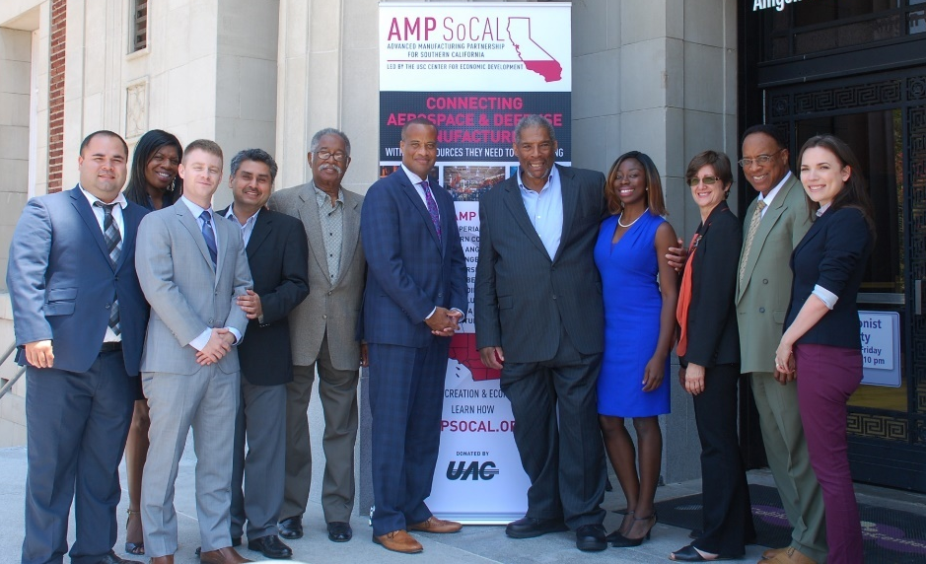
Outreach arm of the Price School of Public Policy
Supports EDA’s mission by
Providing technical assistance to economically distressed and underserved communities
Developing strategies to enhance collaborative regional innovation
Planning
Economic development and policy studies
Feasibility and market analyses
Needs assessments
Capabilities
GIS mapping
Consensus building
Technical assistance workshops
Strategy development
Notes:
Factors complicating the loss in revenue from reduced defense procurement include market consolidation caused in part by Original Equipment Manufacturers shortening their supply chains, graying of the workforce and management, and a lack of succession planning. Those in the commercial aerospace sector are also facing a demand for a 5% cost reduction each year for 2016-2018.
Information sessions and short-term education sessions will be developed and offered on exporting as a strategy for diversifying the customer base. These sessions will educate firms about exporting as a strategy for increasing revenue, identify potential growth markets, and introduce them to available subsidized business planning assistance.

Slide 3
Southern California COVID-19 Pandemic Resilience, Recovery, and Stabilization Program
Goals & Objectives
Assist Main Street and small manufacturing businesses and cities in the project area to recover from the economic shutdown caused by the COVID-19 pandemic;
Retain Main Street and small manufacturing businesses and their jobs; and,
Improve the region’s resiliency by helping business owners and city leaders become prepared for future disruptions

Slide 4
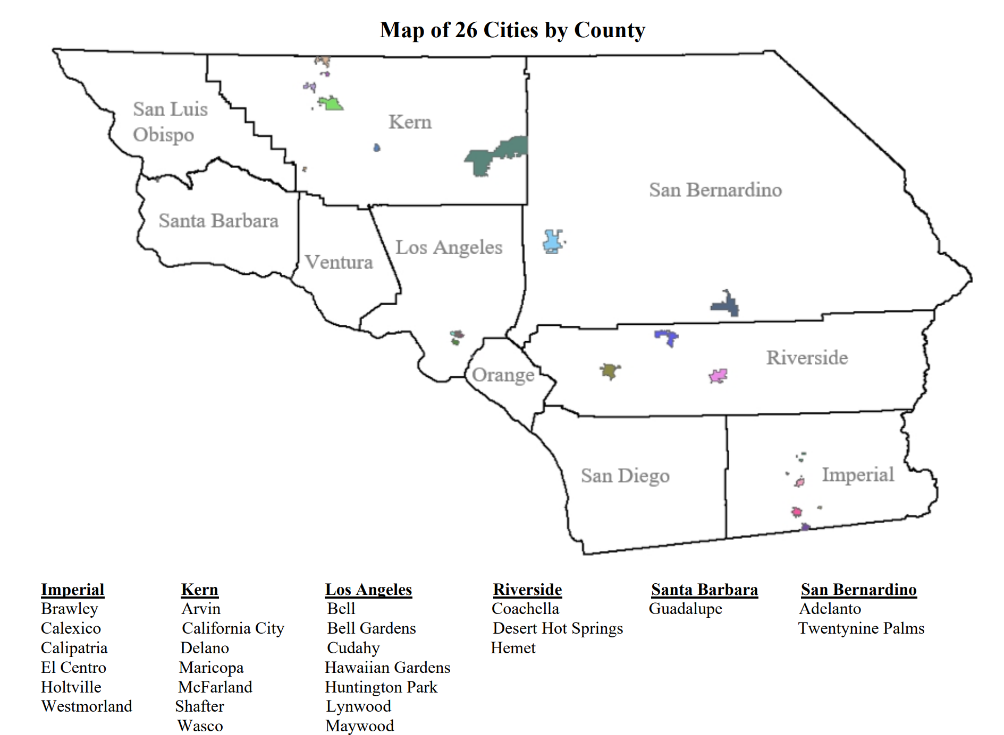
Project Area

Slide 5
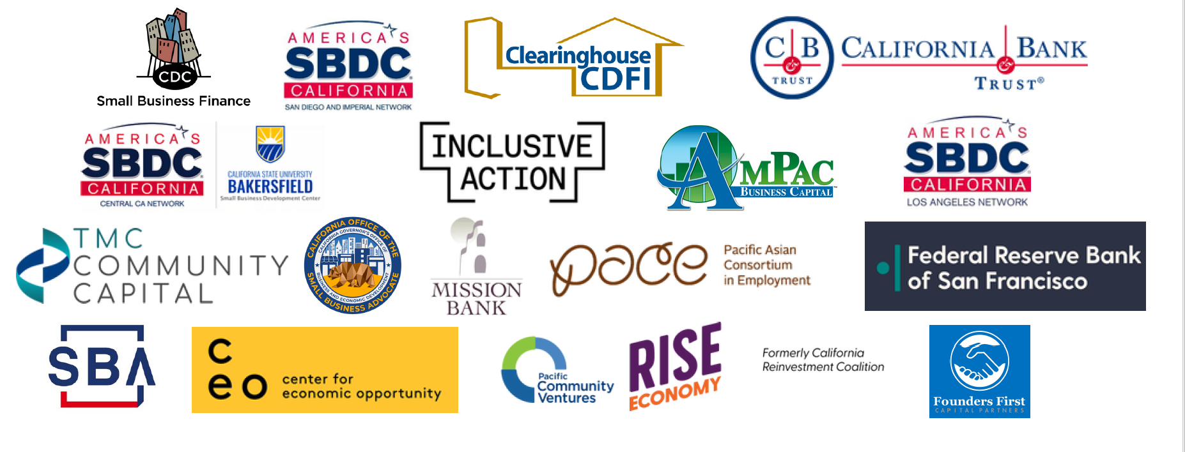
Lenders & Financial Institutions

Slide 6
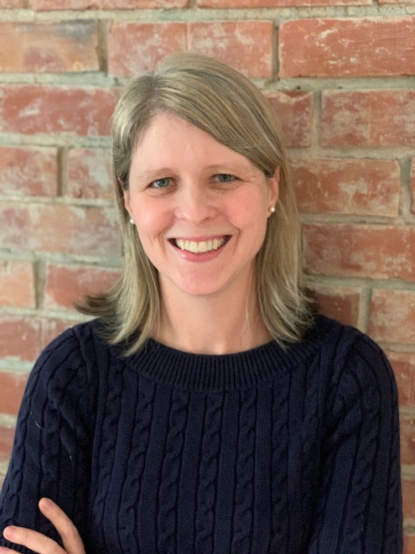
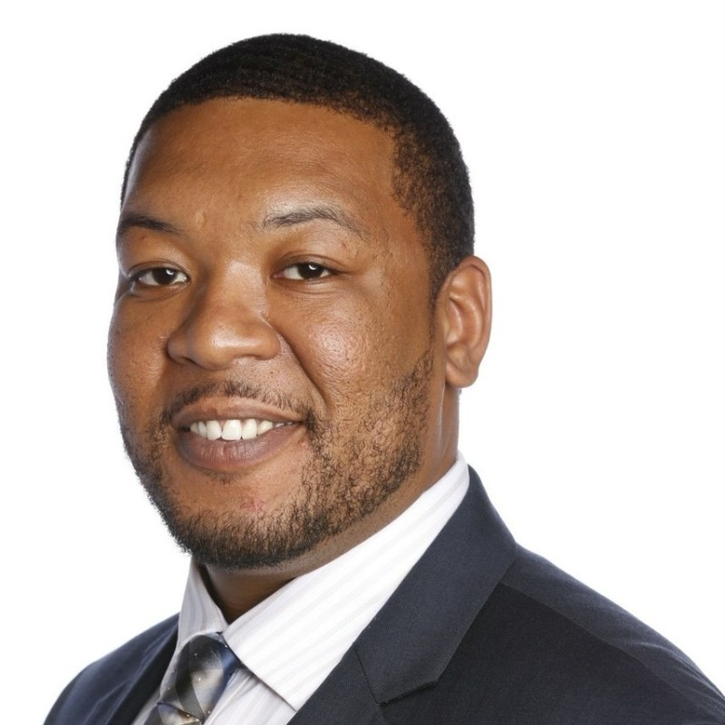
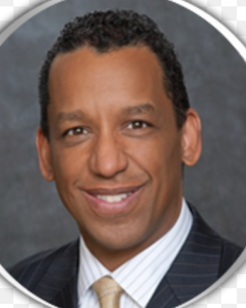
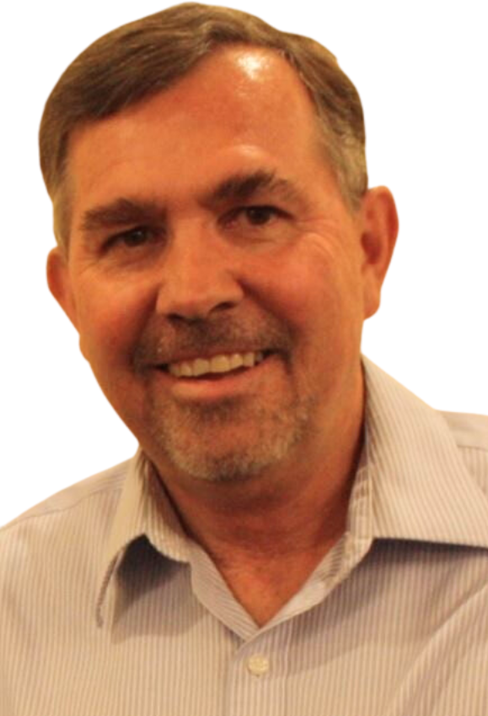
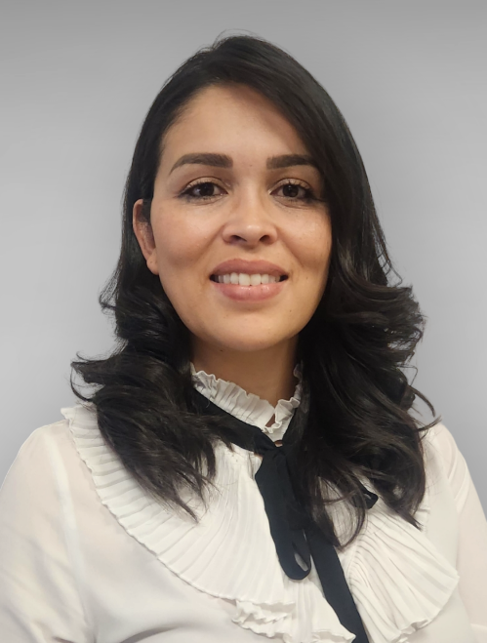
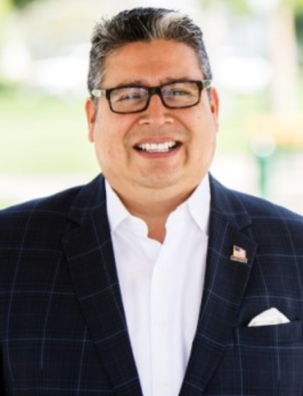
Panel 1: 9:00 am – 10:20 am
Sarah Simms Senior Community Development Finance Manager, FRB of San Francisco
Christopher Earl Assistant Deputy Director, Innovation and Entrepreneurship & Southern CA Regional Advisor Cal OSBA
Richard Pallay Jr. Deputy District Director, SBA
Kelly Bearden Director, CSU Bakersfield SBDC
Viridiana Rosales-Trujillo Interim-Manager & Business Project Advisor Imperial County SBDC
Max A. Ordonez
LA SBDC Business Advisor

Slide 7
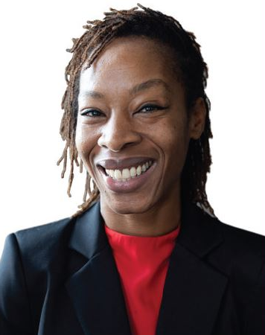
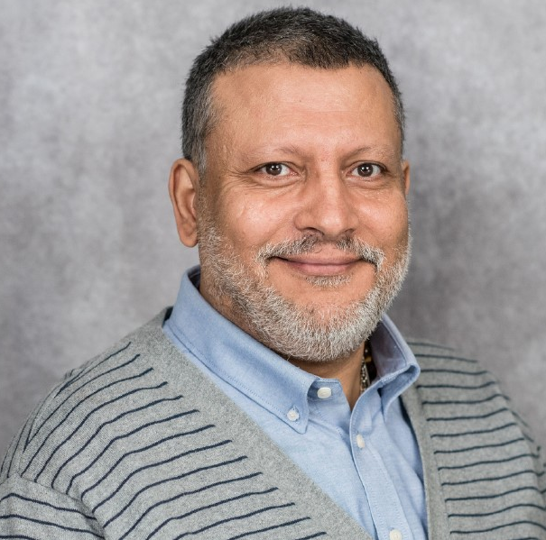
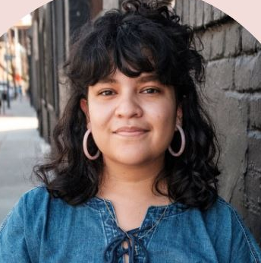
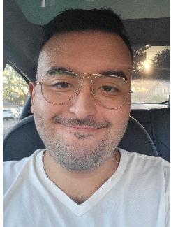
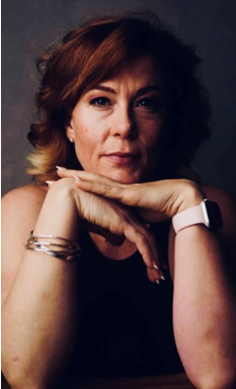
Panel 2: 10:20 am – 11:40 am
Iman Cotton Small Business Loan Officer CDC Small Business Finance
Jennifer Whelan, CFA Senior Loan Counselor, Business PACE LA
Ahmed Zwin, MBA EVP-Director of Government Guaranteed loans AmPac Business Capital
Alyssa Lopez Underwriting Associate Inclusive Action for the City
Alberto Enriquez Credit Analyst
Pacific Community Ventures
Eleanor Boli Associate Director of Corporate & Community Partnerships, PCV
Mayra Contreras
Director of Partnerships TMC Community Capital

Slide 8
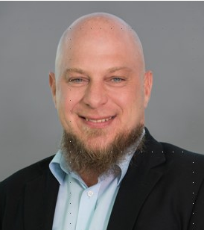
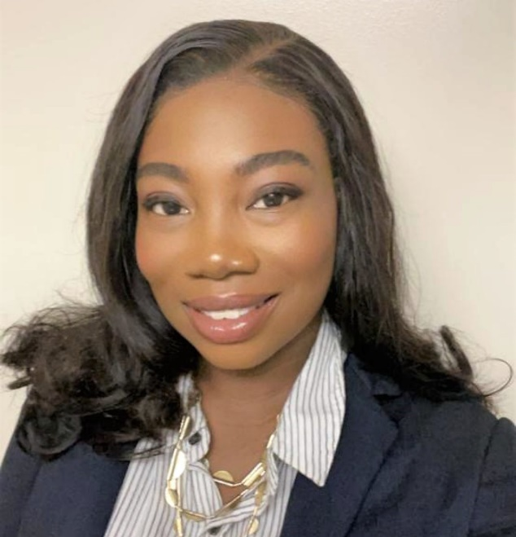
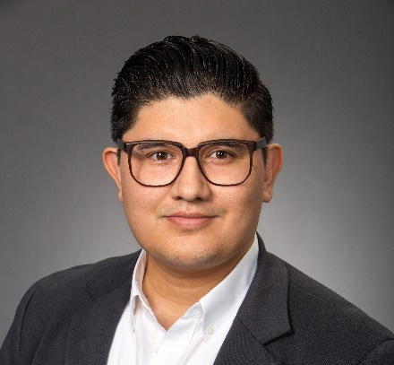
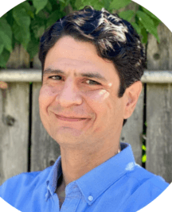
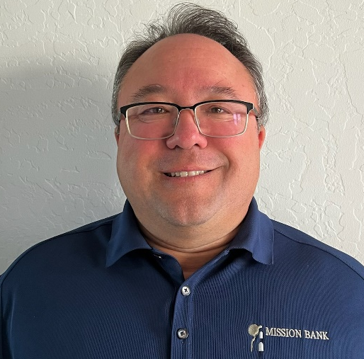
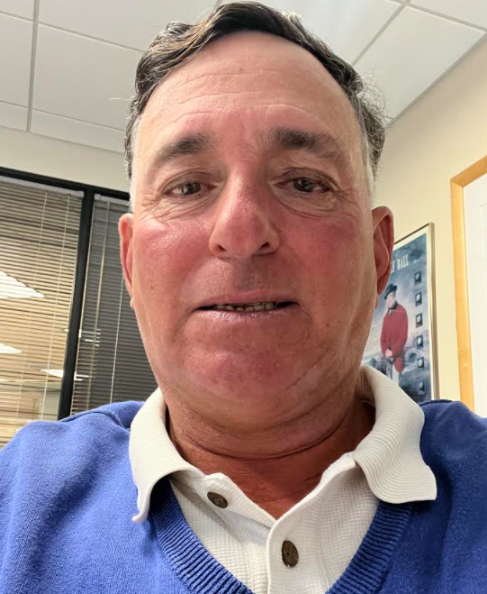
Panel 3: 11:40 am – 1:00 pm
Brian A. Sagert, MBA Business Development Officer Clearinghouse CDFI
Yehwroe S. Martyn Resilience Fund Program Manager RISE Economy
Oscar Franco Investment Manager Founders First Capital Partners
Kasra Movahedi Executive Director IRC Center for Economic Opportunity
Craig Howells SBA Division Manager Mission Bank
Lew Murez
First Vice President, Business Center Manager California Bank & Trust

Slide 9
Thank You
Deepak Bahl, M.B.A., M.Pl., M.Arch.
Program Director
USC Center for Economic Development
Adjunct Associate Professor
CPA 385, Sol Price School of Public Policy
University of Southern California
Los Angeles, CA 90089-7273
bahl@usc.edu
Speaker bios are available on the Center website: ced.usc.edu
Speaker presentations will be posted on the Center website: ced.usc.edu

