Slide 1


MISSION:
Provide fast and affordable online financing and foster financial stability among women-owned, low-income, and under-resourced small businesses in California.
Notes:
N/B

Slide 2
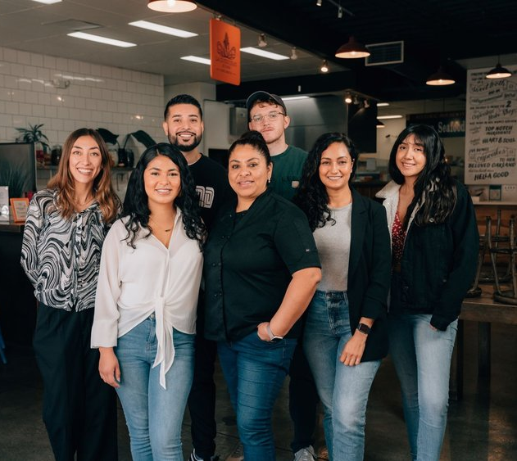
OUR PROGRAMS
LOAN PRODUCTS
For small businesses in California
$5,000-$50,000
Affordable loans with fixed rates and no hidden fees
Easy, online application with fast approval
EDUCATIONAL CONTENT
Beyond the Hustle – content rooted in community starring the community
  Available on our YouTube – TMC Community Capital
Notes:
N,B (partner story)

Slide 3
Loans - Eligibility criteria
For profit California business owner
In operation and generating revenue for at least 12 months
Excluded Industries → Adult entertainment, Cannabis, RideShare, Speculative Industries
*No Minimum FICO Score*
Accept ITIN businesses
Notes:
N

Slide 4
Microloan Lite
Microloan
$5,000 - $15,000
12 – 36 months
6 -7% fixed interest rate
5% processing fee
$15,001 - $50,000
12 – 60 months
6% - 9% fixed interest rate
5% processing fee
DOCUMENTATION NEEDED:
Last 6 months of business bank statements
Last 6 months of personal bank statements – if they reflect revenue
Proof of Business – Any of the following: Business License, Sellers Permit, DBA
Valid Government issued Photo ID – state DL/ID, US or foreign passport, matricula
DOCUMENTATION NEEDED:
ALL docs needed for a Microloan Lite PLUS
Personal & Business Income Tax Returns (prior year, all pages)
  May be recommended to also include the prior year Profit and Loss Statement.
Notes:
B

Slide 5





OPTIONAL DOCUMENTs – These always Help :)
Other statements that reflect revenue:→Venmo, Cashapp, PayPal, Shopify, Square, …etc.
Additional source of income if not reflected as direct deposit on bank statements → Most recent paystub, SSI award letter, …etc.
Collateral* (If Applicable and possible)
  If able to pledge collateral → Copy of the Title or Registration of Commercial OR Personal vehicle that will be pledged for collateral.
Notes:
B

Slide 6
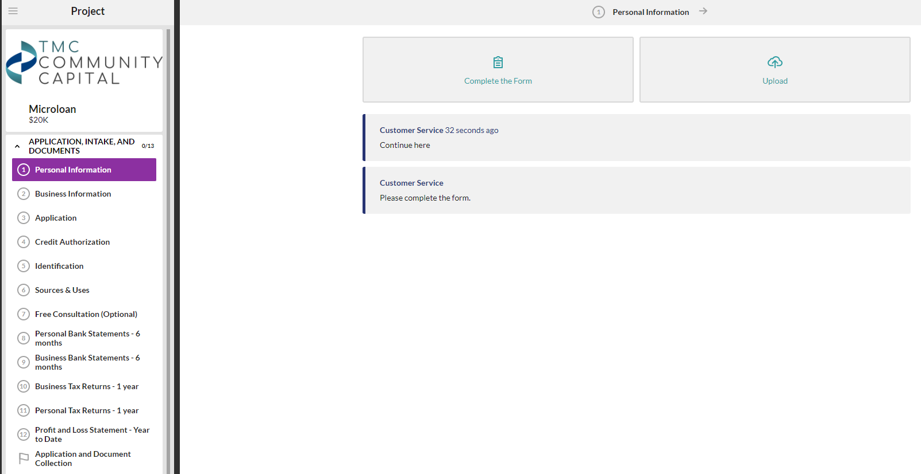
How to apply
We use Lenderfit to intake clients interested in applying for a loan and collect documentation. Clients can gain access to this application through:
Website - https://www.tmccommunitycapital.org/loans
Community Partner can assist the client with filling out the application and uploading documents through the application portal
Notes:
N

Slide 7





Natalie Del Toro
Program Support Specialist
Email: natalie@tmccommunitycapital.org
Direct Line: 415-655-5474
Mayra Contreras
Director of Partnerships
Email: mayra@tmccommunitycapital.org
Direct Line: 415-655-5419
Notes:
Add social media

