Slide 1
Access to Capital
Presented by
Jennifer Whelan, CFA / Senior Loan Counselor
PACE Business Development Center

Slide 2
Overview of Ways to Start and Fund a Business
Case Study: Joe has been working for ABC Plumbing and Heating Services for 5 years.
Joe has been putting money into his savings account.
Joe believes he has the skills needed to start his own business instead of working for ABC.
What should Joe do?

Slide 3
What Joe should do?
To Obtain a plumber’s license
To register a company or DBA name
To open a bank account for the business
To look at his own finance situation
Enough money to purchase the equipment needed?
Enough money to pay all personal bill if no income for 3 months, at least?
Need to find other ways to fund the business, e.g., equity, debt, other types of financing?

Slide 4
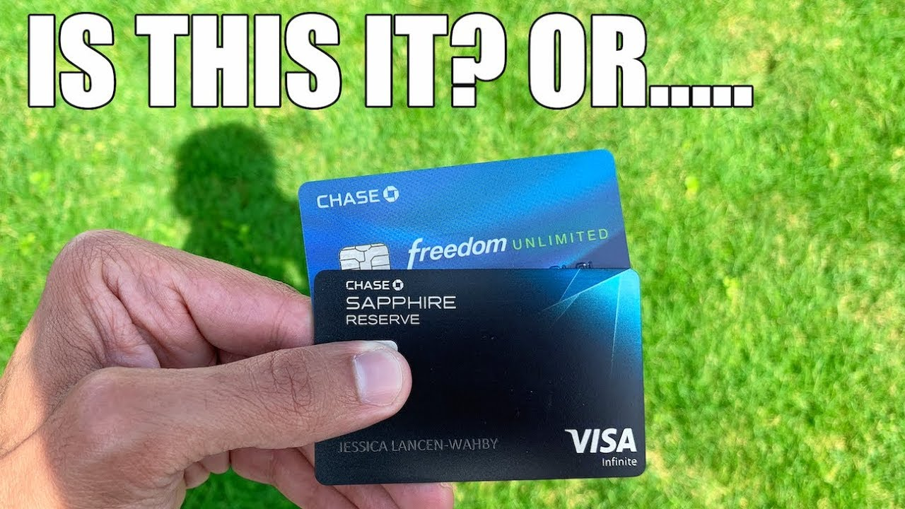
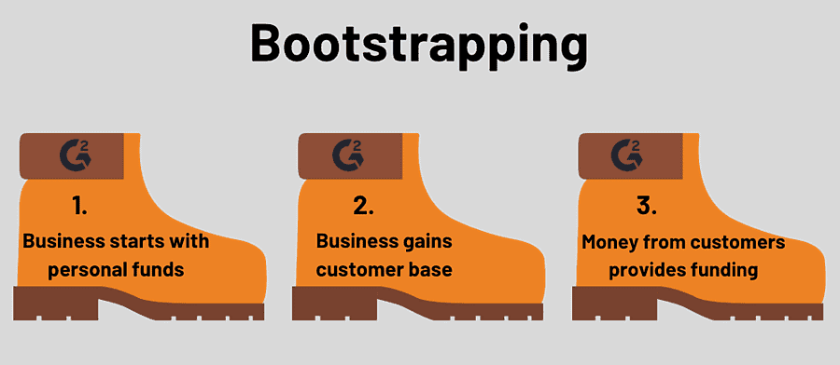
Financing – Owner’s Fund
1. Owner’s Fund – Boot Strapping
Personal savings, retirement account
Personal credit card

Slide 5
Financing – Equity Financing
2. Equity Financing
Equity Financing is an exchange of money for a share of business ownership.
It is generally come from investors who expect little or no return in the early stages but require much more extensive reporting as to the company's progress.
Angel investors
Venture Capital
Joint Ventures/Strategic Partnerships

Slide 6
Financing – Debt Financing
3. Debt Financing
Debt financing means borrowing money that is repaid over a period of time, usually with interest.
Debt financing does not sacrifice any ownership interests in your business.
Debt typically carries the burden of monthly payments, whether or not you have positive cash flow.
In smaller businesses, personal guarantees are likely to be required.

Slide 7
Financing – Debt Financing
3. Debt Financing:
Business credit card
Loan (secure and un-secure loan): banks, CDFI, on-line lenders, private lenders
Line of credit
Receivable Factoring
Purchase Order Advances
Equipment Leasing
Customer Prepaid

Slide 8
Financing – Other
4. Other types of financing
Grants:
Through the SBA: entrepreneurs who have research-related businesses.
Grants offer by various entities. For example, Grants mentioned by LISC.
Your customers / create a loan program for your customers
Your vendors
Crowdfunding

Slide 9
PACE Loan Programs
Products:
SBA mini-micro loan: below $5K
SBA micro loan: $5K to $50K
SBA 7a community advantage loan: up to $350K
California Small Business Loan Guarantee Loan: up to $350K
Start-up business can be considered, ITIN holder can be considered (max loan amount is $5k), ORR loan ($1K to $15K)
Unique products
Contract Finance Assistance Loan “CFAP”

Slide 10
Unique products: CFAP Loan (offered by PACE and MWIS)
Loan amount: $50,000 to $250,000
Loan Term: up to 24-months, based on the project length
Interest Rate: 7%-9% (subject to change)
Mush have awarded Contract/Accounts Receivable used as collateral or “best available”
Third party funds administrator is required

Slide 11
CFAP Loan (cont.)
Loan fee: PACE loan fee 1% plus $25 credit check fee /per guarantor
State Guarantee fee of 2.5% of the loan amount & $250 documentation fee
1% Third party funds administration fee, if applicable.
Merriwether & Williams Insurance Services (“MWIS”) is PACE’s partner to underwrite CFAP loan.

Slide 12
HOW TO PREPARE?
1. Brief Summary: business, owner(s) bio, key management bio, capability statements
2. Projections:
REALISTIC, 1 to 3 years, monthly for the first 12-month,
With detailed assumptions
How the numbers were calculated
Helps the underwriter understand -> Lends Confidence in the management of the operations
Non-profit organizations can assist you

Slide 13
HOW TO PREPARE?
3. Company Financials – Company Cash flow
Tax returns (2 to 3 years)
Interim business financial statement, including AR/AP schedules, aging
Bank statements: to verify liquidity
4. Personal Financial Information – Global Cash flow
Personal Credit Score
Personal Tax returns, Bank Statements

Slide 14
How PACE Can Help
Training
Startup workshops
Business workshops
Entrepreneur Training Program (ETP)
1 on 1 Counseling
Startup
Operations & Expansion
Lending
Credit Building
Grant Application
Credit /Asset Building
Mini microloans
(Up to $5,000 for credit building)
SBA Microloans
(Up to $50,000)
CA Loans /
IBank
(Up to $350,000), including CFAP loan
Packaging
LA City Loan
Interest-Free Loan
Unsecured Loan
KIVA Loan
Contracting Support
Procurement
Women-Owned Small Business Certification
Service-Disabled Veteran-Owned Business
Small Disadvantaged Business
8(a) Business Development Program
Bank Partners’ Loans

Slide 15
Q&A
Jennifer Whelan, CFA
Email: jwhelan@pacela.org
Phone: 626-416-5293
http://pacelabdc.org; www.pacela.org

