Slide 1
Small Business Funding & Raising Capital
“EXISTING and Start Up
Business Financing”

Slide 2

Today’s Topics
Introduction
Common Ways to Fund A Business
Microfinance and Alternative Lending
Preparing My Loan Package
Assistance
Success Story
Questions
√
√

Slide 3

Preparing My Loan Packaging - business:
Business Information Needed:
Develop a business/growth plan
Develop a 24-month forecast (month by month)
Be specific on funds request
Be clear on use of funds
Must state your Capital Infusion
Refine & practice financial pitch
Answer Covid Questionnaire

Slide 4
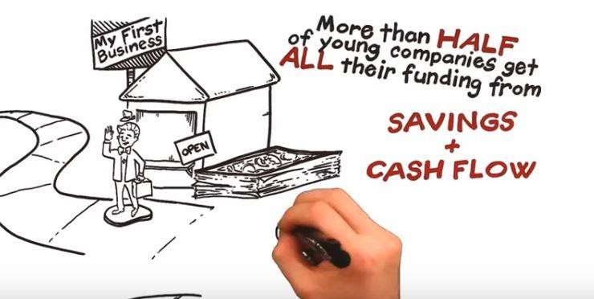
The “You” part of My Loan Packaging
Personal Information Needed:
Personal Financial Statement (PFS)
Outside Income or Other Income
Personal Tax Returns
Personal Credit
Collateral – may be necessary

Slide 5

How We Help:
One-on-one: Assistance and guidance with experts in their respective fields and/or industries
and;
Workshops: Online and in-person business educational training
No Cost to entrepreneurs
Business Fundamentals:
Business Planning: Launch, expand, or pivot
Marketing Strategies: Website, social, e-commerce, branding
Operations: HR, licensing, procurement, international

Slide 6
Client Success Story:
Meet Danh Tran of Butter Cloth
www.buttercloth.com
SBDC assisted with:
Venture capital assistance
Business valuation
Pitch deck presentation
Result:
Landed a slot on ABC’s Shark Tank
Received $250K funding from Robert Herjavec

Slide 7
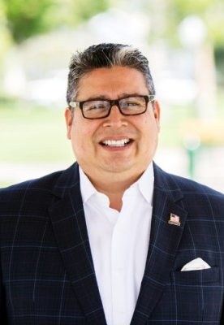
MAX A. ORDONEZ
SBDC Business Advisor
562-938-5155
mordonez@smallbizla.org
Los Angeles Regional Small Business Development Center Network
Notes:
Add email and phone number

