Slide 1
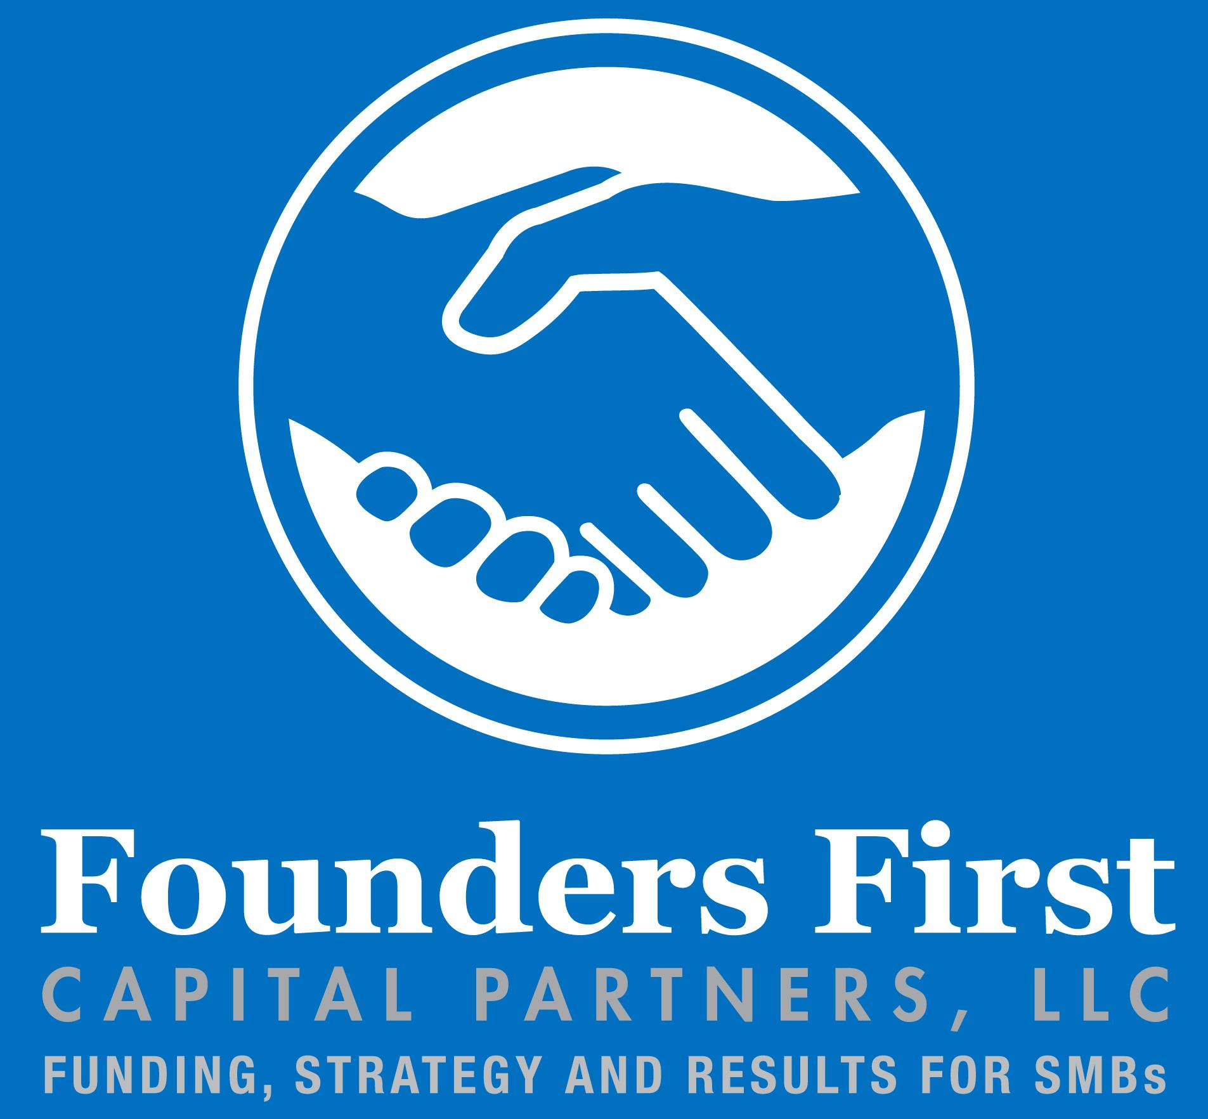
The Benefits of Working with a Revenue-Based Funder
JUNE 22, 2023
This Photo by Unknown Author is licensed under CC BY

Slide 2
ON A MISSION TO MAKE AN IMPACT
Who We Are
At Founders First, our vision for the future is nothing less than an inclusive economy where diverse-led business thrive. Our mission is to solve racial and social economic equity gaps by educating, funding, and connecting growing businesses owned and operated by diverse founders nationwide.
We achieve this through two distinct entities: Founders First Capital Partners and Founders First CDC
Who We Serve
Women
BIPOC
Latinx
Our Impact
Over 800 diverse-led companies served nationally through our nonprofit
Financing from $50,000 to $2M
Asian
LGBTQ+
Veterans
Low to Moderate Income Areas
Businesses Committed to Inclusive Hiring Practices
Notes:
Casey

Slide 3
ADDRESSING THE FUNDING GAP WITH GROWTH CAPITAL
 | Revenue-Based Financing | Term Loans
Ideal Business Focus | Tech, Tech-Enabled, Tech-Adjacent, Consulting, Asset-Light Businesses, or Businesses with Recurring Revenue
Annual Revenue Requirements | $500,000 All States Excluding Texas $1M Texas-Based Companies | $500,000 All States Excluding Texas $1M Texas-Based Companies
Minimum Time in Business | 12 months | 12 months
Payment Model | Variable payments based on monthly gross cash receipts | Fixed monthly payments for the duration of the term
Revenue Model | Companies with recurring or predictable revenue or are on a path-to-profitability | Companies with recurring or predictable revenue or are on a path-to-profitability
Business Model | B2B preferred | B2B preferred
Terms | 2-5 years | 12 months – 5 years
Available Funding | $50,000 to $2M | $50,000 to $2M
Equity Share or Warrants | None required | None required
Financial Covenants | None required | None required
Personal Collateral | None required | None required
Personal Credit Score | Not a barrier to funding | Not a barrier to funding
Notes:
Add Term Loans

Slide 4
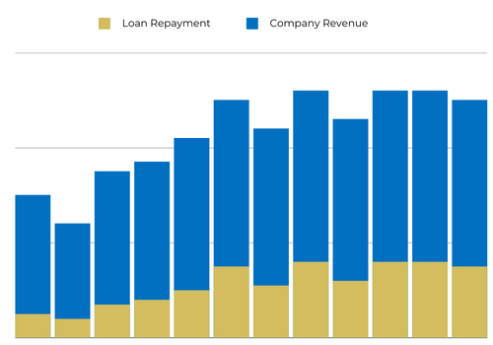
RBF | The Best of Equity and Debt
Limited financial covenants — Payments depend only on company performance.
No loss of control — No board seat, no ability to replace management.
No pledge of specific assets
Aligned interest — Our IRR depends on your performance.
Advice — Here to help and support your growth. (Networking and Advisory Services)
Founders retain value upon exit — No sale of equity. The business owner is able to retain ownership
Notes:
Kush

Slide 5
RBF | Funding Example
Up to $2M or up to 30% of annualized revenue run rate
No set interest rate, monthly payment, or maturity
Monthly payments are variable; fixed percent of revenue
We can come behind an SBA loan or bank loan in the capital stack; refinance less favorable debt
Example Loan
Annual Revenues: $1M
Principal: $200K
Term Length: 3 years
Payment: 2%-5% royalty of monthly revenue
Repayment: 1.3x principal ($260K)
No penalty if paid off early
Loan Maturity
1.2x
to
1.5x
Principal
Cumulative Payments
Principal
Notes:
Oscar

Slide 6
Term Loan | Funding Example
Up to $2M or up to 30% of annualized revenue run rate
Set interest rate
Fixed, monthly payment until the end of term
We can come behind an SBA loan or bank loan in the capital stack; refinance less favorable debt
Example Loan
Annual Revenues: $1M
Principal: $200K
Term: 3 years
Payment: fixed $7,222 per month
Repayment: 1.3x principal ($260K)
No penalty if paid off early
Loan Maturity
1.2x
to
1.5x
Principal
Cumulative Payments
Principal
Notes:
Oscar

Slide 7
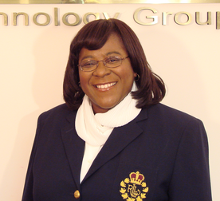
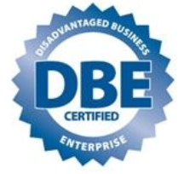
Case Study | OnShore Technology Group
About OnShore Technology Group
Valarie King-Bailey is the CEO of OnShore Technology Group, an independent Chicago-based consultancy founded in 2004 specializing in Independent Validation and Verification (IV&V) services and solutions. Valarie has over 34+ years of international experience in the life sciences technology industry.
Before FastPath
Service-based business limited options for capital and margin growth
Need growth capital for product marketing and implementations
Need to fund staff adds to respond to demand
Revenues were mostly services, transactional lumpy sales
Post FastPath, Funding and Expansion Support
$500K Revenue-based investment, closed August 2020
Grew revenue pipeline 3X in 2020 from 2019
Adding 3 new team members; (2) Engineers (1) Biz Dev
Adding new AI product extension
Streamlining BizDev, Financial Health and Operations KPIs
Notes:
Kush

