Slide 1
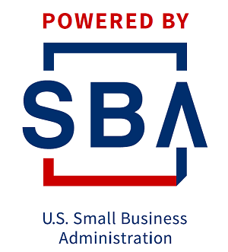
Alternatives, Trends and Quick Lending Concepts
Kelly Bearden, CSU Bakersfield SBDC
June 22, 2023

Slide 2
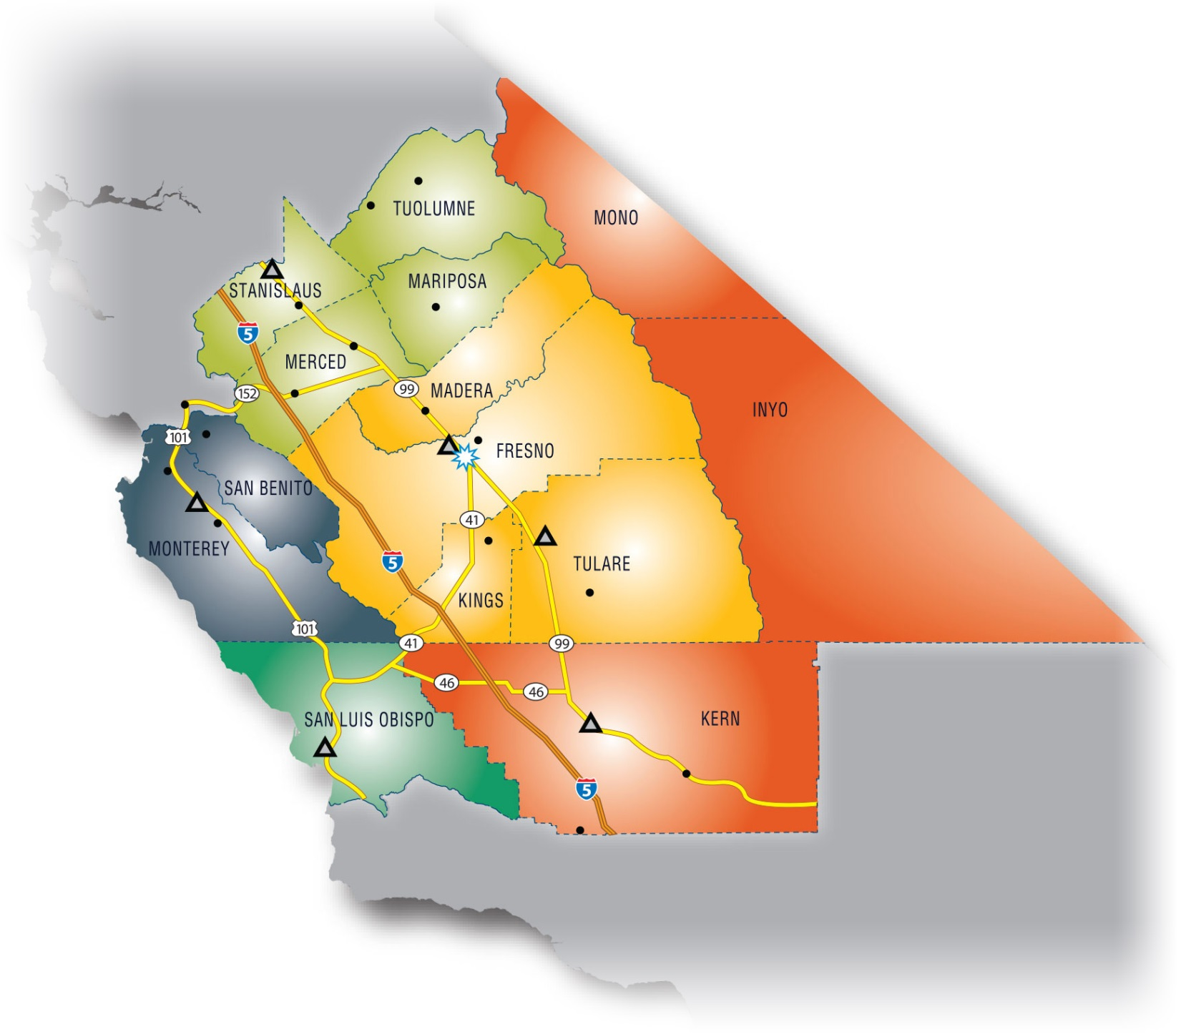
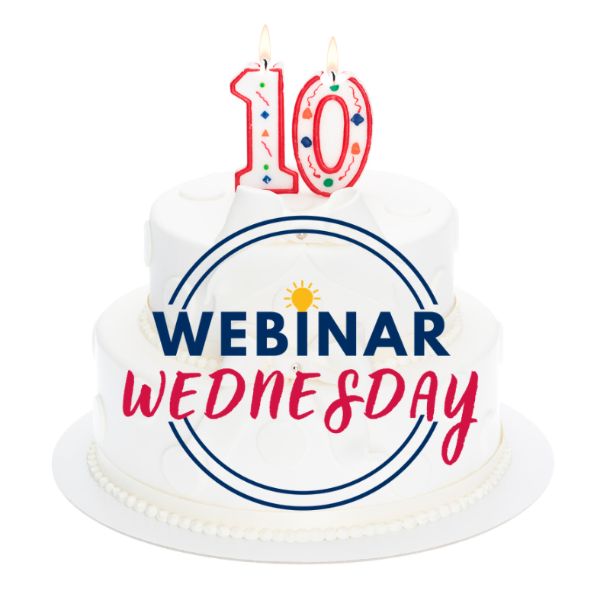
Central California SBDC Region
The SBDC Network serves 14 counties in Central California. We provide no-cost, personalized, confidential, one-on-one consulting for start-ups and existing businesses. Areas of help include:
Accessing capital (debt, equity, investment)
Interactive business planning featuring Live Plan
Using the Blueprint to find your business model
Government contracting assistance
Marketing & social media
Turnaround specialty consulting
Cash flow forecasting
E-commerce assistance
Human resources
Detailed market research through SBDC.net
And more!
To request assistance, go to www.csubsbdc.com and click “help” to find your service area.

Slide 3
Is There Money For Everyone?
Community Revolving Loan Funds from Cities, Counties, States
Transactional Lenders – UCC Blanket Collateral
Bank Loans
State Guaranty Program Lenders – 7 FDC’s in CA – Funds Non-profits
Online Lending Sites – FinTech Companies
Owner “K” – 401k = C Corp Injection
Invoice / Accounts Receivable Financing
Purchase Order Financing
Equipment Leasing
Hard Money
Credit Card Financing
Crowdfunding
Lines of Credit
Strategic Partnering/ Joint Ventures
Friends & Family
Bootstrapping
Owner Financing of Business Sale
CDBG Over the Counter State Funds
EB5 Visa
Loans from Interested Partners (AMEX), Specific Industry Lending (Trucking)

Slide 4
What are some pros and cons FinTech Lenders?
They are fast, easy and don’t usually ask for security or collateral
They usually serve existing businesses with a track record
They often estimate or know revenues through a merchant card portal
They are great if you need cash fast and can afford the debt
Often quite expensive on an Annual Percentage Rate (APR) basis
Total interest and fees are determined at set at loan signing
Daily payment can create cash flow issues
For “all in” borrowers another option when you are low on options

Slide 5
How are FinTech deals structured ?
Loan Amount: $50,000
Interest and/or fees $23,456
Term: Daily, 20 months
Payment: Daily $ 120.67
Interest Often Not Shared, what is the APR?

Slide 6
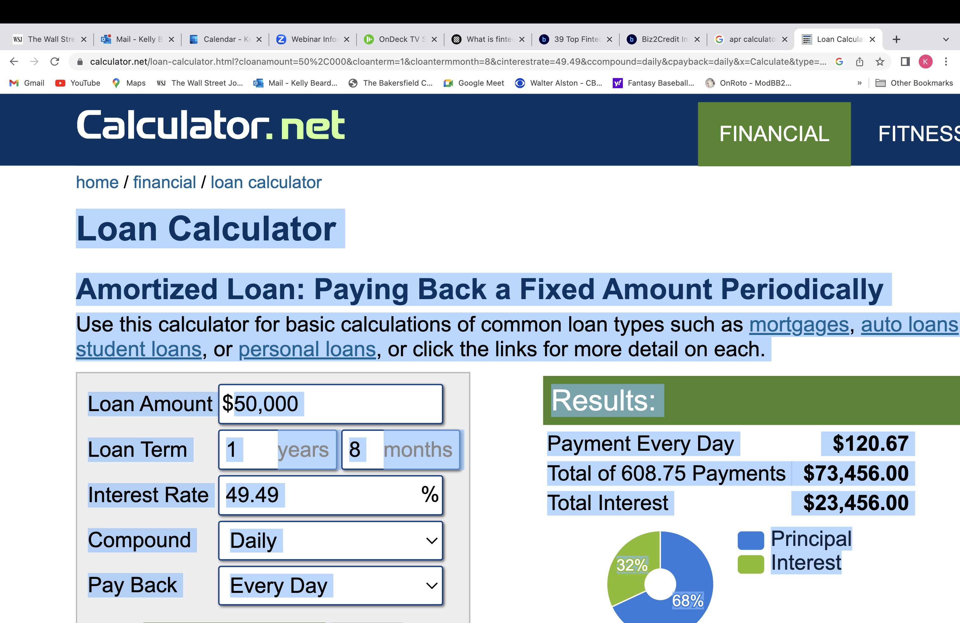

Slide 7
What is the APR your FinTech Charging?
Loan Amount: $50,000
Fees added to loan: $23,456
Term: Daily amortization & Daily payment, 20 months
Payment per day $ 120.67
REAL APR = 49.49%
Dang! I’m paying 49.49%, I’m going to pay it off after 10 months, what is the APR now?

Slide 8
What is the APR your FinTech Charging?
Pay it off after 10 months, what is the APR now?
Basically double, you are paying the same total amount of interest, over half the time!
99.98%

Slide 9
Final thoughts….
Creativity, common sense funding take aways
There are many ways to fund or grow a business
Look for unique ways to fund
Think of multiple, smaller resource options
Know if you’re bankable, near bankable or not bankable
No debt options, look for investment capital
Get advice, funding is not easy

Slide 10
Central California SBDC Region
Thanks!
Google SBDC to contact an SBDC near you!
Kelly Bearden, Director
CSU Bakersfield SBDC
kbearden@csub.edu
csubsbdc.com
661.654.2856

