Slide 1

What To Expect When Applying For a SBA Loan- Tips To Know Before You Apply.
Presented by:
Iman Cotton
Loan Officer
CDC Small Business Finance/Momentus Capital

Slide 2

Today’s Topics
I. Introduction
II. Types of Loans
III. The 5 C’s of Credit
IV. CDC Loan Products
V. Success Stories

Slide 3
Today’s Topics
Introduction
Types of Loans
The 5 C’s of Credit
Success Stories
3

Slide 4

What is a CDC?
CDC = Certified Development Company
CDCs are certified by the SBA (Small Business Administration) to administer SBA 504 loans.
CDCs are private, non-profit entities with a mission to provide business financing to those who aren’t quite strong enough for bank financing.
260+ CDC’s in the country
4
Notes:
Discuss – mission based lender . Funds to lend come from interest on loans we service, and or grants, or loans the company takes, and premiums earned on the secondary market. The sale of the guaranteed portion of SBA 7a loans.
Largest in the nation - #1 in SBA 504 loans and # 1 Community Advantage Lender.
Reference – lender ranking- handout.

Slide 5
What is a CDFI?
CDFI = Community Development Financial Institution
CDFIs help promote access to capital and local economic growth in urban and rural low-income communities across the nation through monetary awards and the allocation of tax credits.
Financial institutions certified by the CDFI Fund are eligible to apply for monetary support and training to build organization capacity.
CDFIs are specialized financial institutions that provide financial products and services to populations and businesses located in underserved markets.
These institutions have community development missions and a reputation for lending responsibly in low-income communities. CDFIs include banks and bank holding companies, as well as credit unions, loan funds, and venture capital funds.
More than 1300 CDFIs
5
Notes:
Discuss – mission based lender . Funds to lend come from interest on loans we service, and or grants, or loans the company takes, and premiums earned on the secondary market. The sale of the guaranteed portion of SBA 7a loans.
Largest in the nation - #1 in SBA 504 loans and # 1 Community Advantage Lender.
Reference – lender ranking- handout.

Slide 6
Speed /Risk Impact Rates & Terms
Low Doc –No Doc
Business financials
Minimal forms
Low FICO or No FICO
Fully Underwritten
Taxes – business & personal (3yrs)
Financials
Forms
FICO Minimums
89%
Rate
45%
8%
2 weeks
30-60 days
Time

Slide 7
Documents required to apply
Start-up
Business Information:
-CDC application (attached)
-Business debt schedule (attached)- if your business does not have debt, please sign/date and write "none".
-Business Plan and 2- year Projections (templates attached)
-Lease Agreement for the space your business intends to occupy. (contract does not need to executed)
-Bid for Tenant Improvements if TI's are part of your project
Personal Information:
Submit for anyone who holds 20% or more ownership in the business.
-Personal Tax Returns for the most current year. (all pages)
-Personal Financial Statement (attached) - spouse must sign as well
-Personal Expense form (attached)
- Most recent pay stub from all sources of income (spouse as well)
-If you don’t own your home and pay rent personally, please indicate how much you pay in rent.

Slide 8
Documents required to apply
Existing
Business Information:
- CDC application (attached)
- Business debt schedule (attached)- if your business does not have debt, please sign/date and write "none".
- 6 months of most current Business Bank Statements
- 2 years of most current Federal business tax returns (all pages)
- 2022 Profit & Loss Statement and Balance Sheet
- 2023 Interim Profit & Loss Statement and Balance Sheet
Personal Information:
Submit for anyone who holds 20% or more ownership in the business.
- Personal Tax Returns for the most current year. (all pages)
- Personal Financial Statement (attached) - spouse must sign as well
- Personal Expense form (attached)
- Most recent pay stub from all sources of income (spouse as well)
- If you don’t own your home and pay rent personally, please indicate how much you pay in rent.

Slide 9
Documents required to apply
Acquisition
Business Information from Buyer:
-CDC application (attached)
-Business debt schedule (attached)- if your business does not have debt, please sign/date and write "none".
-Business Plan and 2- year Projections (templates attached)
-Lease Agreement for location you will be leasing for the business. (contract does not need to be executed)
-Bid for Tenant Improvements if TI's are part of your project
Personal Information from Buyer:
Submit for anyone who holds 20% or more ownership in the business.
- Personal Tax Returns for the most current year. (all pages)
- Personal Financial Statement (attached) - spouse must sign as well
- Personal Expense form (attached)
- Most recent pay stub from all sources of income (spouse as well)
- If you don’t own your home and pay rent personally, please indicate how much you pay in rent.
Business Information from Seller:
-3-years of most current Business Tax Returns (all pages)
-Profit & Loss Statement & Balance Sheet- must be current within 40 days

Slide 10
Not all SBA
lenders are the same….
SBA Standard Operating Procedure (SOP) provides the rules, processes, and guidelines a SBA Lender may, must or should follow.
The Credit Box/internal credit policy – determines the lender’s appetite for risk. i.e. minimum FICO scores, collateral requirements, length of time in business.
Notes:
Note the terms -
DSC
LTV
FICO
When you apply to a lender and are turned down, you were not declined by SBA – declined by that lender. Know the difference between SBA rules /eligibility and lenders appetite for risk.

Slide 11
Types of Loans
Term Loans- principal and interest payments paid over a term, typically for a specific purpose.
Line of Credit – Interest paid on outstanding balance. Balance can be drawn down and repaid over the life of the Line. Typically renewed annually or over multiple years, based on certain credit conditions.
Merchant Cash Advance – an advance against future credit card payments received from customers, not a loan.

Slide 12
How You Plan to Use the
Money Matters
Business Acquisition/ Change of Ownership
Equipment
Refinancing Debt
Working Capital
Start-up - Tenant Improvements
The SBA SOP and the Lender’s Credit Policy or Credit Box will determine the rules and willingness to lend for a specific use of loan proceeds.

Slide 13
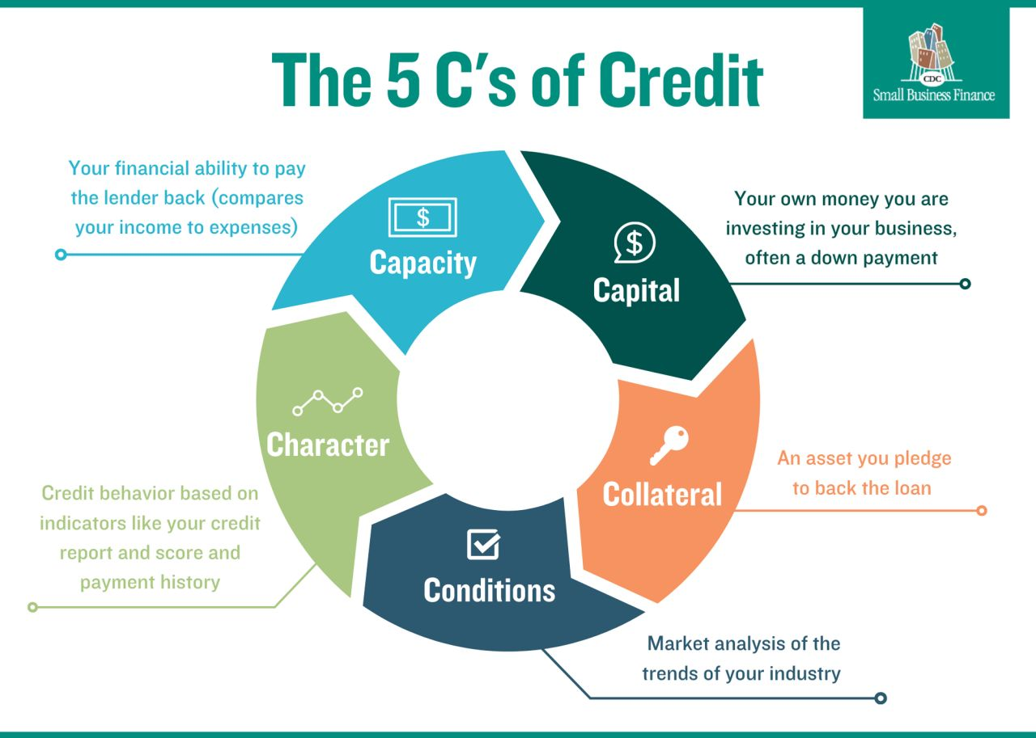

Slide 14
Conditions
What experience do you and the other primary business owner(s) and operator(s) have in your industry?
If you do not have direct experience, who will you hire?
How will your skills/abilities allow you to successfully
operate this business?
How do the current economic conditions affect your industry?
Lease terms – Does the location matter?

Slide 15
Capacity – CASH FLOW IS KING
Business Income:
Profit on recent tax returns and interim financials
Projected income for new businesses or those planning significant expansion
Personal Income:
Other employment
Other businesses
Spousal
Military
Cash flow for personal and business debt repayment
Business profits
Personal outside income

Slide 16




Capital
Capital - Funds the business owner(s) will put into the
business for this project.
Sources:
Savings
Home equity line of credit
Partner contributions
Family and friends (gifted)
Start-up >10- 20% injection required
Business Acquisition > 10% injection required ( amounts vary depending on lender)

Slide 17
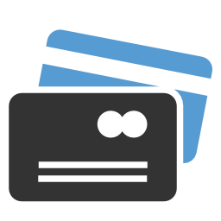
Character
Personal Credit of:
Anyone with 20% or more ownership
in the business
Spouses of business owners
Co-signers
Credit Score:
Payment history
Percentage of revolving debt available
Length of credit history
Types of credit:
Revolving & Installment debt
Credit Resources:
www.annualcreditreport.com
www.credit.org
Notes:
Refer to handout

Slide 18
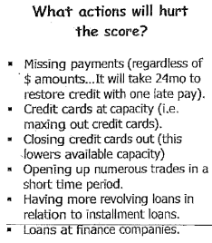
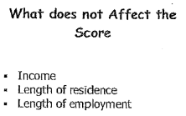
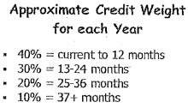
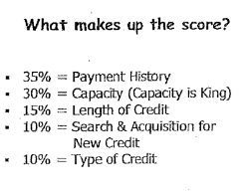
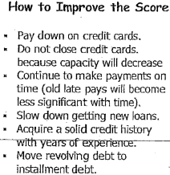
Understanding
Your Credit Score

Slide 19
Collateral
Collateral - Tangible assets that can be sold by the lender in the event that the business is not able to repay the loan. SOP requirements are based on loan amount and use of proceeds
SBA SOP for loans over $350,000 not for RE, must aim to be fully secured.
Common forms of collateral:
Personal Residence – if the property has equity when valued at 85% of the present market value.
Business Assets – all inventory and equipment owned by the business
Personal Assets – personal vehicle, cash
LTV = Loan to Value: loan amount/collateral value

Slide 20
SBSS – SBA Predictive
Index Score
The SBSS score is simply a calculation tool the SBA uses to assess the likelihood a borrower will pay back the loan. The score is an indicator of the strength of the request. The SBA sets a minimum score to process the loan PLP and or lender may have an internal minimum requirement.
The score is based on:
Personal credit history of all owners of 20% or more of the business.
  Debt to credit available is an important factor. Capacity
Business credit history
Impacted by time in business – and # of accounts
Time in business
Risk level of the industry

Slide 21
SBA 504- 90 % Fixed rate
With an SBA 504 loan, money can be used to buy a building, finance ground-up construction or building improvements, purchase heavy machinery and equipment, or refinance debt
$125,000-$20 Million
Fixed
  10 yrs – equipment
  20-25 yrs real estate
  Down Payment – Minimum 10%

Slide 22
SBA 7a Loan
7a loan proceeds can be used for short-term or long-term working capital, to purchase an existing business, refinance business debt, or equipment or CRE.
$50,000- $5 million
Rates – variable, Prime + index ( depending on loan size)
Greater than $350,001 = Prime + (0-3%)
  $250,000 - $350,000= Prime + (0-4.5%)
  $50,000 - $250,000 = Prime + (0-6%)
Terms – depends on use of proceeds 5-7 yrs. working capital, 10 yrs. business acquisition, 10-15 equipment,20-25 yrs. real estate.

Slide 23
What kinds
of
loans do we make?
Reasons a bank may not fund a business, but CDC Small Business Finance will include:
  Start up Businesses
  Early-Stage Businesses
  Weak cash flow
  Weak collateral
  Credit issues
  Small dollar request

Slide 24
SBA Micro Loans
Offered directly by CDC Small Business Finance and other approved micro lenders
Loan Range: $10,000 - $50,000
Loans offered for viable businesses that do not meet bank requirements
Rates: 8.75 % ( currently, based on cost of funds) -fixed
Terms: 3-6 years
Post-loan business counseling is required

Slide 25
Community Advantage
Loan Program
Allows non-bank lenders to make SBA 7a loans. Offered directly by CDC Small Business Finance & other approved alternative lenders.
CDC covers: All states besides North Dakota, South Dakota, Tennessee, Utah (limited), Vermont, and Alaska
Loan Range: $10,000 - $350,000
Loans offered for start-ups, existing businesses, expansions, business acquisitions, debt refinance and CRE.
Rates: Prime + 4.5% to Prime + 5%
Terms: 5-10 years

Slide 26
Impact Loans
Focused on serving African-American and Latino small business owners and businesses located in low- and moderate-income areas.
ONLY California – State Guaranteed Loan
Loan Range: $10,000 - $350,000
Loans offered for start-ups, existing businesses, expansions, business acquisitions, debt refinance and CRE.
Rates: Prime + 4.5% to Prime + 5%
Terms: 10-year amortization due in 5 years

Slide 27
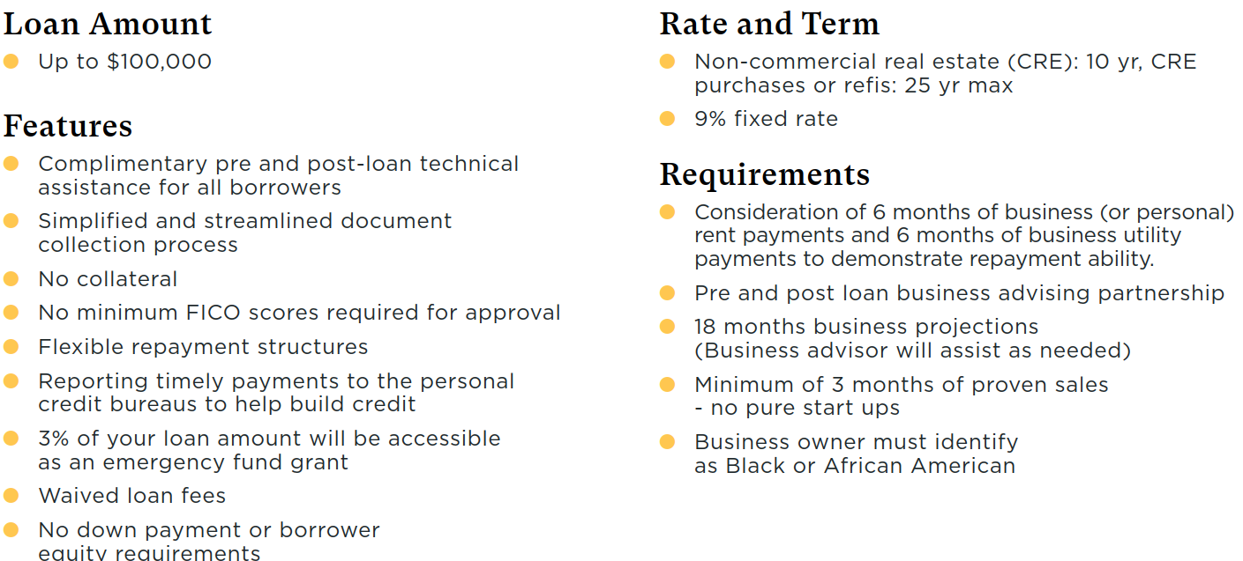
Activate South LA (June)

Slide 28

Success Stories

Slide 29
Start-up
Project: Needed funds to create additional products, secure an employee, and pay off debt.
Referral Source: LinkedIn
  Credit: Low 600
  Collateral/ Guarantors: UCC 1 on business assets
  Cash Flow: (projections-based request plus one year of bus tax returns)
  Capital - $36,500 (gifted) – Plus has current w2 job.
  UOP –working capital, equipment, debt consolidation

Slide 30
Existing Business
Project: Seamstress who needed more material
$50,000 – working capital
  Referral Source: bank
  Credit: Mid 600’s
  Collateral/ Guarantors: UCC 1 on business assets
  Global Cash Flow: (personal and business returns)
  UOP – Purchase inventory
  Great Experience, extremely tight cash flow, bank declined

Slide 31


THANK YOU.

